Slide 1

BU Spark! Athletics

Slide 2
Key Tasks to Complete
Complete Base Question 1-3
Preprocess
Analysis
Visualization
Interpretation
Data Documentation
Upload data & code (Q1-3) with proper documentation
Preparation for Base Question 4-6
Read through the questions
Come up with an approach
Preliminary analysis (individually)

Slide 3
PROCESS
Complete Base Question 1-3
Preprocess
Analysis
Visualization
Interpretation
Data Documentation
Upload data & code (Q1-3) with proper documentation
Preparation for Base Question 4-6
Read through the questions
Come up with an approach
Preliminary analysis (individually)

Slide 4
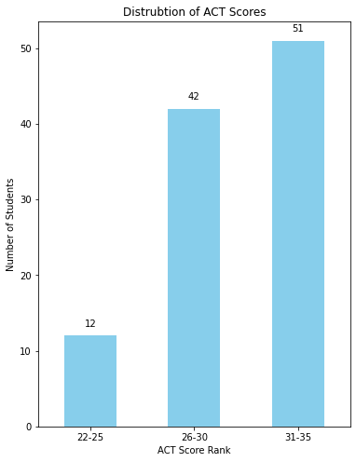
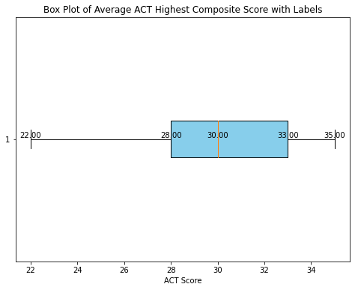
Key Output - Q1
Range of Accepted ACT scores: 22-35 (out of 36)
Notes:
national average for ACT score: 19.9 -> all accepted BU athletes were above the national average
105 have ACT scores, range from 22-35 points out of 36. In 2024, the national average for ACT scores is 19.9, which means all accepted BU athletes were above the national average.
The median is 30, with 50% of the students ranging from 28-33, 25% lower than 28 and 25% above 33

Slide 5
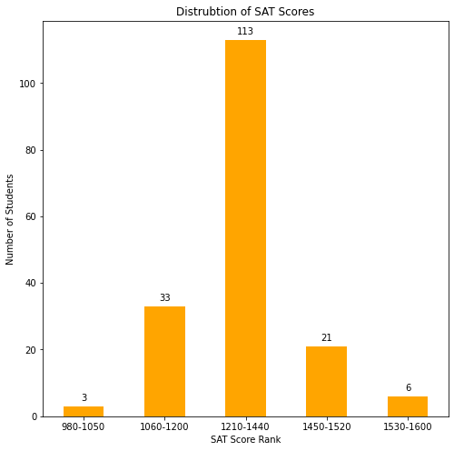
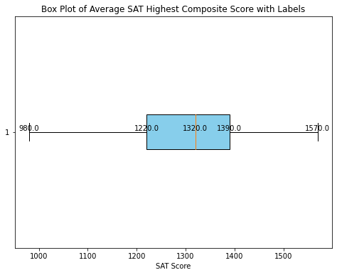
Key Output - Q1
Range of Accepted SAT scores: 980 - 1570 (out of 1600)
Notes:
average SAT score: 1050, 75th percentile: 1200, 90th: 1440, 95th: 1520
176 have SAT scores, range from 980-1570 points out of 1600. In 2024, the national average SAT scores is 1050, 75th percentile is 1200, 90th percentile is 1440, 95th percentile is 1520, compare with the box plot and bar plot, meaning we have 3 students that’s below national average (lowest 980 is around 30th percentile), average is 1310, which is 260 above national average, and we have 27 above 90th percentile, 6 above 95th percentile (max: 1570 is around 99th percentile)

Slide 6
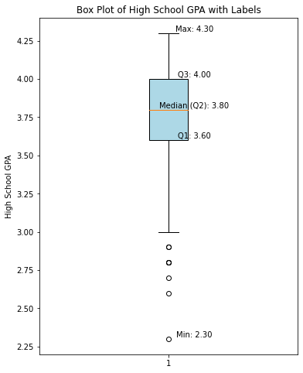
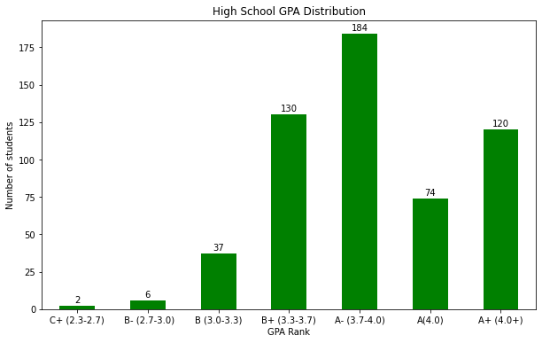
Key Output - Q1
Range of Accepted HS GPA: 2.3 - 4.3 (out of 4.5)
Letter Grade | Percent Grade | 4.0 Scale
A+ | 97-100 | 4.0
A | 93-96 | 4.0
A- | 90-92 | 3.7
B+ | 87-89 | 3.3
B | 83-86 | 3.0
B- | 80-82 | 2.7
C+ | 77-79 | 2.3
C | 73-76 | 2.0
Notes:
All accepted students have a HS GPA above C
For the bar plot and box plot, for simplicity, the data is categorized into 6 ranks (shown on the left):
C+ (2.3-2.7), B- (2.7-3.0), B (3.0-3.3), B+ (3.3-3.7), A- (3.7-4.0), A(4.0), A+ (4.0+) (A+ rank for those enrolled in AP program)
Bar Plot: the distribution of HS GPA based on letter grade (all accepted students have a HS GPA above C), at least 120 students enrolled in AP program
Box Plot: Several outliers (anyone below 3.0), 8 students, majority have GPA above B, 50% students have GPA between 3.6-4.0, Interquartile range is 0.4, which is a relatively small range, indicating a high academic performance for most students

Slide 7
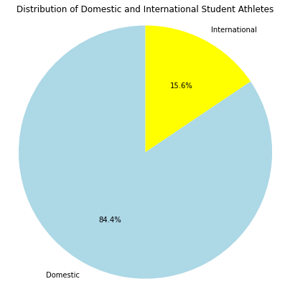
Key Output - Q1
Number of Domestic Students: 526 (out of 623)
Number of International Students: 97 (out of 623)

Slide 8
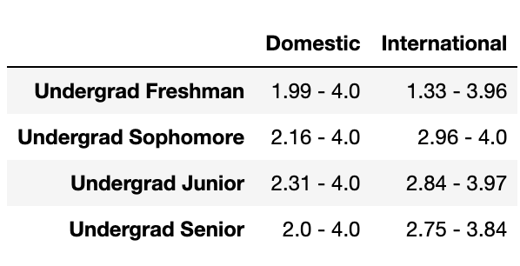
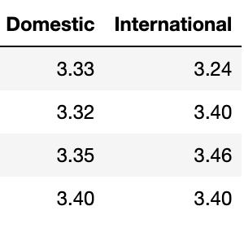
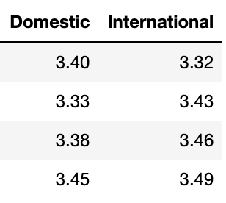
Key Output - Q1
Range
Mean
Median
Notes:
Does English being the primary language of the country impact the students’ performance?
English as a primary language may not significantly impact the long-term academic performance
Compare the range, mean, median of BU GPA (latest cum GPA) between domestic and international students
Undergrad Freshman: domestic generally performs better than international students
Sophomore - Senior: international has high mean and median (but no 4.0) => international students might need a period of adjustment

Slide 9
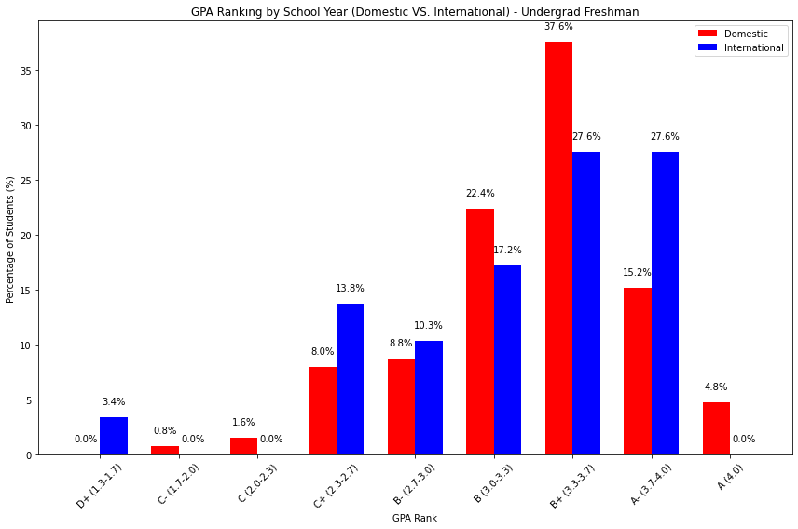
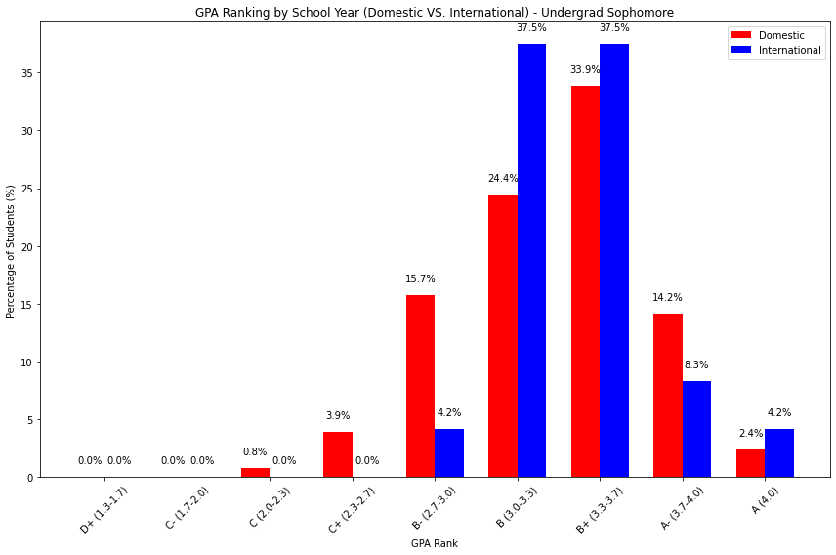
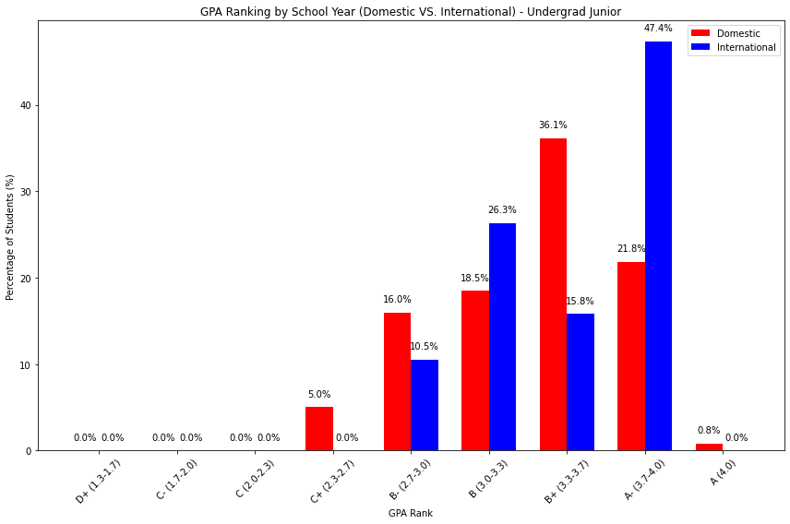
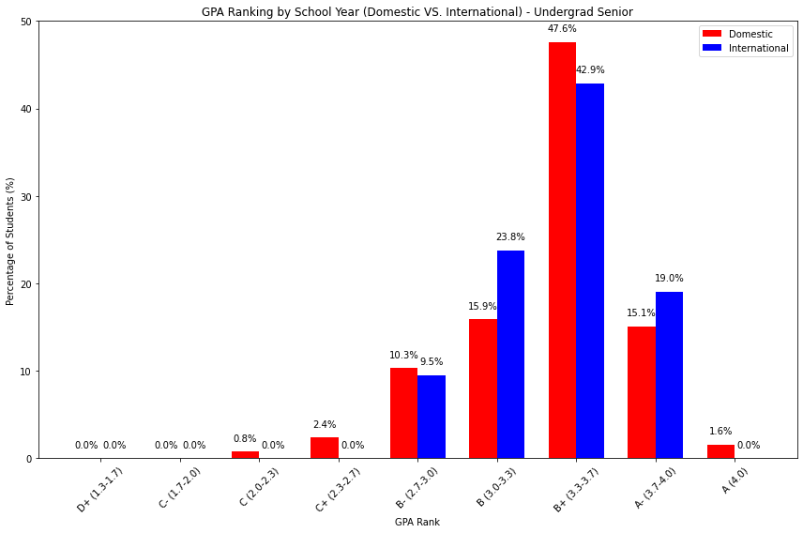
Freshman
Sophomore
Junior
Senior
Notes:
GPA distribution by school year (domestic VS international)
domestic-red; international-blue
the distribution of college GPA for domestic and international students is similar but with some variations, in several GPA ranges, international students often perform similarly or sometimes better than domestic counterparts, especially in higher GPA categories (Junior, A- rank, 47.4% VS. 21.8%) In short term, we did see the impact: 3.4% international students having D+

Slide 10
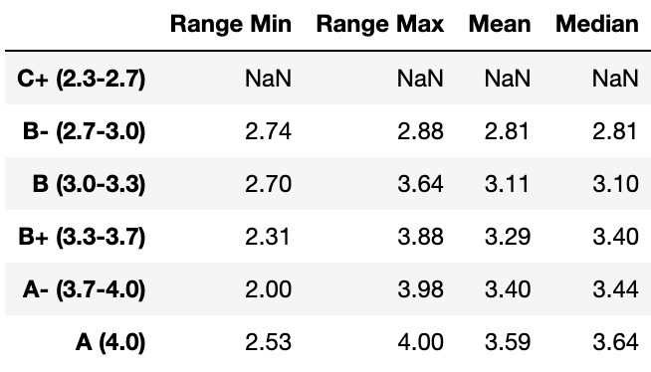
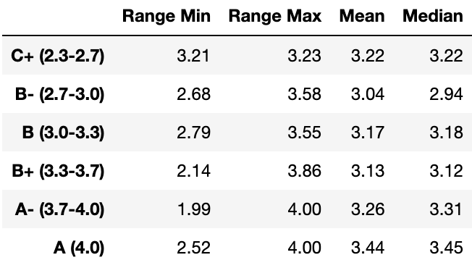
Key Output - Q1
With ACT/SAT scores
Without ACT/SAT scores
Notes:
How does the academic performance of students with similar HS GPAs compare (those with SAT/ACT vs. those without SAT/ACT score submitted)?
Cap HS GPA to 4.0 scale (any GPA above 4 is capped to 4)
For students with similar high school GPAs, those who submit SAT/ACT scores tend to perform slightly better on average, particularly in the higher GPA ranks. However, the performance variability is quite similar across both groups, indicating having ACT/SAT scores does not drastically alter the variability in college academic performance.
Row: HS GPA Rank
Students without ACT/SAT scores vary larger in college GPA than those with (C+ - A VS. B- - A)
C+ - B HS GPA: doesn’t really have a correlation (with/without ACT/SAT scores), those without even shows better performance
B+ HS GPA: higher min, mean, median

Slide 11
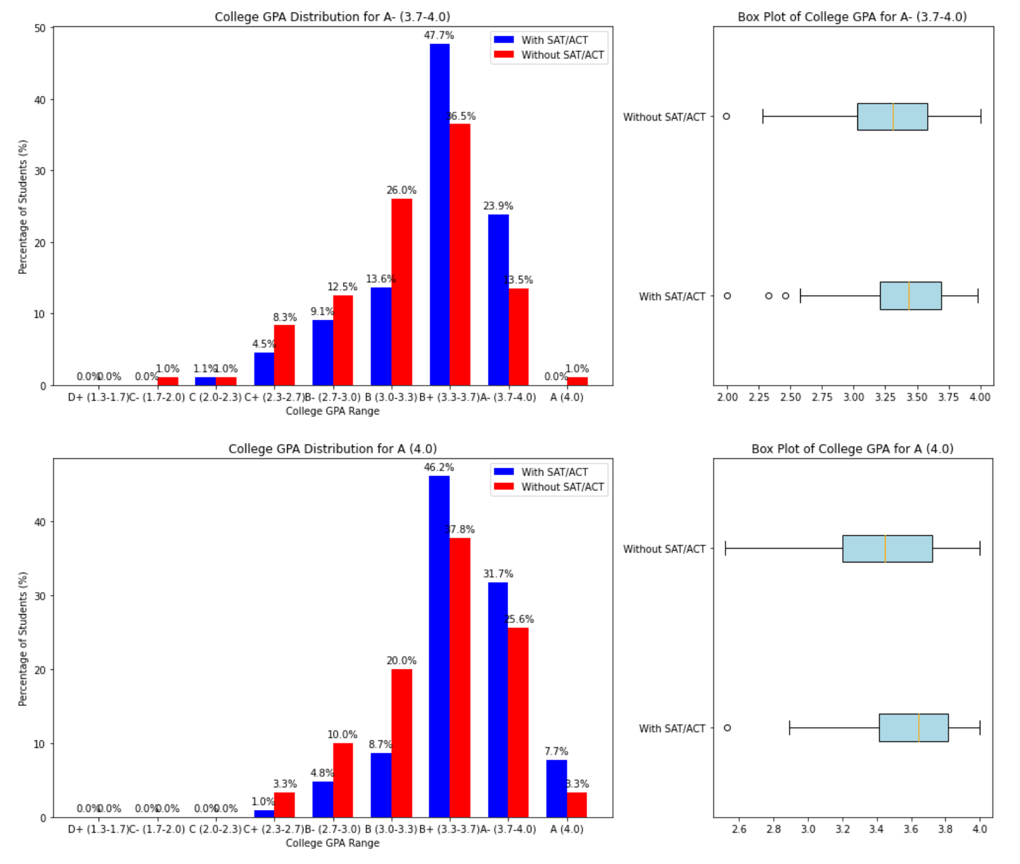
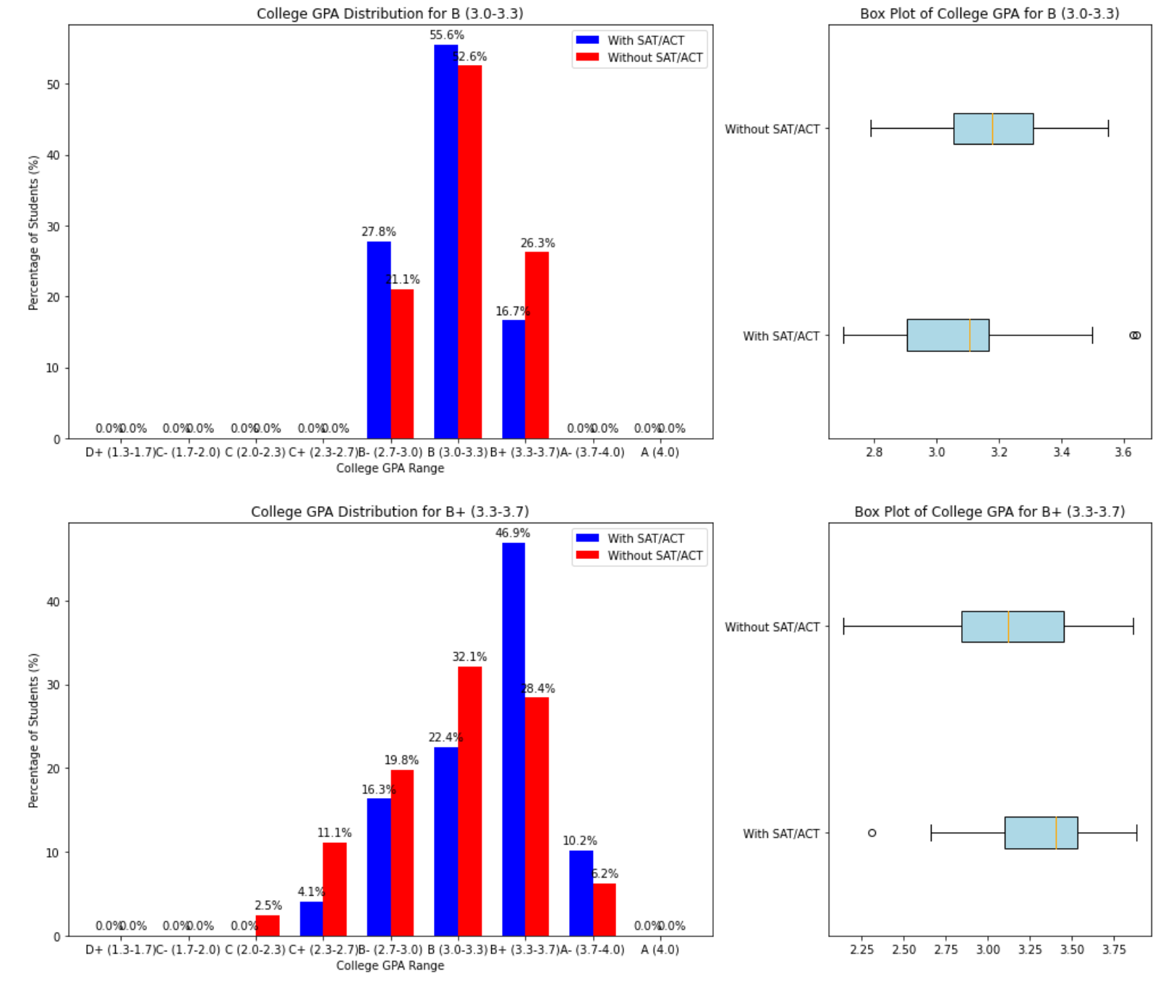
HS A-
HS B
HS A
HS B+
Notes:
College GPA Distribution based on HS GPA Rank
blue-with, red-without
Bar charts: For most GPA ranks, the distribution of college GPA among students with/without SAT/ACT scores is fairly similar. However, students with SAT/ACT scores tend to have a slightly higher representation in the upper GPA ranges and students without often have more students falling into the mid-range GPAs
Box plots: students with SAT/ACT scores have slightly higher median GPAs across most HS GPA ranks. The range of GPA is typically wider for students without, indicating more variability in their academic performance.

Slide 12
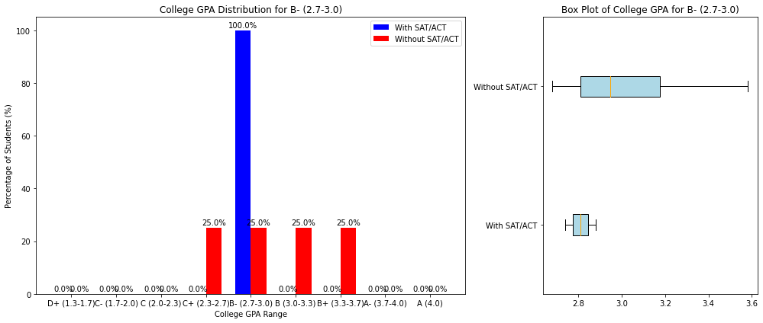
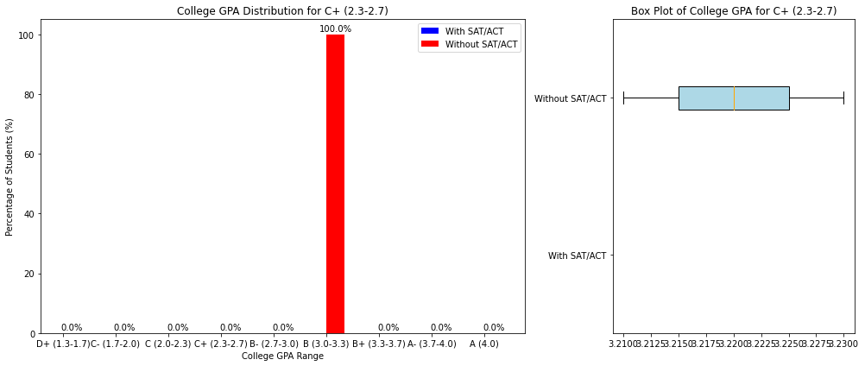
HS B-
HS C+

Slide 13
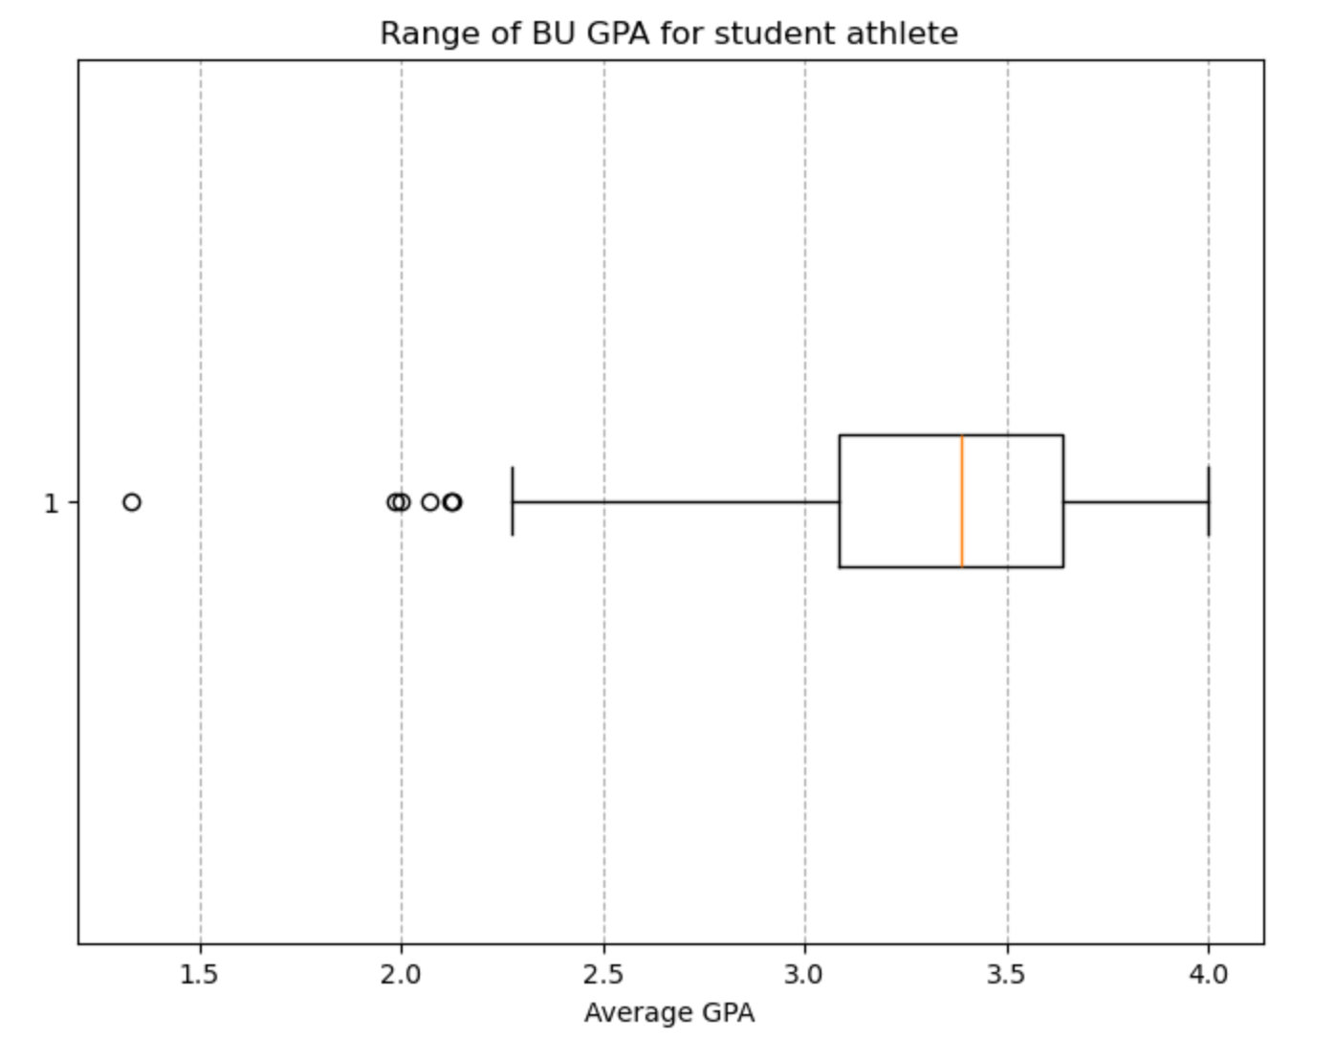
Key Output - Q2
Q2: What is the range of BU gpa for student athletes
Minimum BU GPA for student athletes: 1.33
Maximum BU GPA for student athletes: 4.0
GPA Range: [1.33, 4.0]
50% of students have a GPA between 3.1 and 3.6.
25% of students have a GPA lower than 3.1.
25% of students have a GPA higher than 3.6.

Slide 14
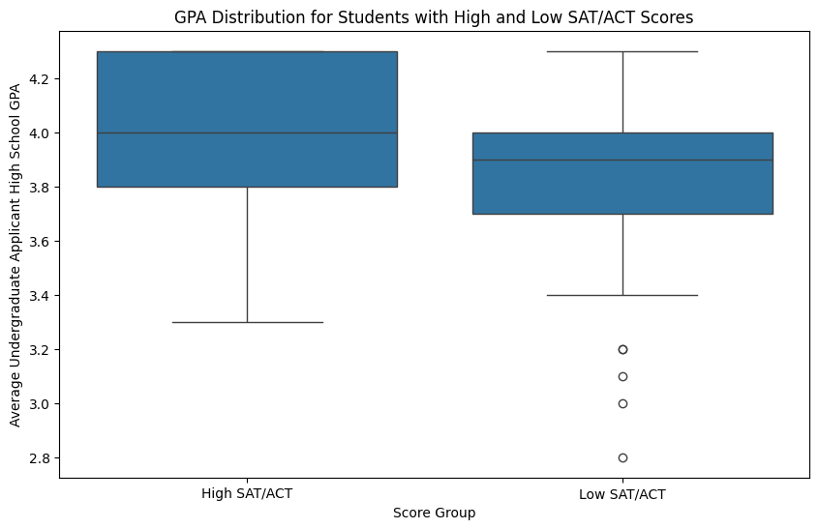
Key Output - Q3
Difference between High & Low SAT/ACT Scores Group:
Median Difference: 0.1
1st Quartile (Q1) Difference: 0.1
3rd Quartile (Q3) Difference: 0.3
Mean Difference: 0.17

Slide 15
High SAT/ACT Scores Group:
Median: 4.0
1st Quartile (Q1): 3.8
3rd Quartile (Q3): 4.3
Mean: 3.98
Standard Deviation: 0.27
range: [3.3,4.3]
Low SAT/ACT Scores Group:
Median: 3.9
1st Quartile (Q1): 3.7
3rd Quartile (Q3): 4.0
Mean: 3.81
Standard Deviation: 0.31
range: [2.8,4.3]

Slide 16
Blockers
Based on the current analysis, is there any other area you would like us to explore more?
Currently, when comparing college GPA, we used the latest cumulative GPA. Do you think this is the right approach, or would you prefer that we go a step further and analyze the data on a semester-by-semester basis?

Slide 17
Future steps
Next Meeting Time: Nov. 8
Explore & Add all the missing points mentioned in today’s meeting
Upload Modified Data & Code with proper documentation
Complete Base Question 4-6
Brainstorm strategies
Analyze and visualize the problems

Slide 18

Thank you!

